Slide 1
Design Thinking Project Title: Microbial Fuel Cell System (Earth Battery) in Ibarapa North

Slide 2
Project Background
According to President Bola Tinubu (2023), about 90 million people in Nigeria do not have access to electricity. The national grid only serves about 15 per cent of the country’s demand. This has left households and factories to rely on expensive self-generation, which supplies a staggering 40 per cent of the country’s demand.
MFC system (Earth battery), will provide energy solutions to the small households in the villages (Igangan, Aiyete) without electricity in Ibarapa North local government area in Oyo state, Nigeria.

Slide 3

Current Situation in Aiyete & Igangan
Current Energy Sources
Kerosene lamps (locally known as Atupa); Lanterns; Battery-powered lights; Candles
Uses
Lighting
Disadvantages
Smoke/Toxic fumes; Low light levels; Not durable (unsustainable); Fire risks; Environmental pollution

Slide 4
Pain Points (Challenges)
1. Unreliable and insufficient supply affecting availability of lighting
2. Health and safety due to smoke from Atupa and fire outbreak risks
3. Limited access to solar power systems due to upfront installation costs
4. Recurring costs from replacements like torch batteries, kerosene
5. Environmental pollution from Atupa’s harmful emission and physical waste from disposed dry cells
6. Communication impact due to lack of recharging sources for rechargeable devices like mobile phones

Slide 5
Problem Statement
The quality of life for Nigerians without energy is severely impacted by the absence of reliable electricity. Imagine not being able to enjoy a cold drink, iron your clothes, or turn on a fan during sweltering weather.
For the residents of rural communities like Igangan and Aiyete, this isn't just a scenario to imagine—it's the harsh reality they face every day, living in constant darkness.

Slide 6
Expert Interview Findings
Theme 1: Operational & Accessibility Challenge
Supply Issue; Unreliability; Limited Coverage; Economic Burden
Theme 2: Health & Safety Risks
Theme 3: User needs and preferences
Cost-Effective Alternatives

Slide 7
How Might We
1. Solve energy needs for small households in Aiyete and Igangan communities?
2. Design a low-cost and efficient energy solution using locally available resources
that is also environmentally friendly?

Slide 8
Stakeholder Map
Core Team
Involved
Informed
Full time on the project
E.g. project developers, local technicians, community leaders, Igangan and Aiyete residents
Regularly providing input or helping to move work forward, but this project is not their sole focus
E.g. local government and businesses
Wants to stay up to date and will
provide feedback/input when necessary
E.g. NGOs, CBOs, donors, communication outlets, academic institutions

Slide 9
Earth Battery as a Solution
Low cost and locally sourced materials to construct the earth batteries
Eco-Friendly (Clean and renewable) energy producing no harmful emissions
Low maintenance requirements to function effectively
Scalable to meet varying energy demands of small households

Slide 10
MFC Design & Implementation
Stage 1:
Prototype Development & Testing
Stage 2:
Polishing Final Product & Full-Scale Implementation
Stage 3:
Scaling Up & Expanding

Slide 11
Electricity Generating Process using Earth Battery
1. Gather Materials: Collect mud, electrodes (copper & zinc plates), containers, wires, an LED or small device to power.
2. Prepare Electrodes: Insert electrodes into the mud within the container ensuring they are properly spaced.
3. Connect Wires: Attach wires to electrodes connecting the +ve and –ve terminals to the device.
5. Test the Output: Measure voltage generated & observe the LED or device to ensure it’s receiving power.
4. Set up the Circuit: Ensure the circuit is complete, allowing electrons to flow from the anode to the cathode.

Slide 12
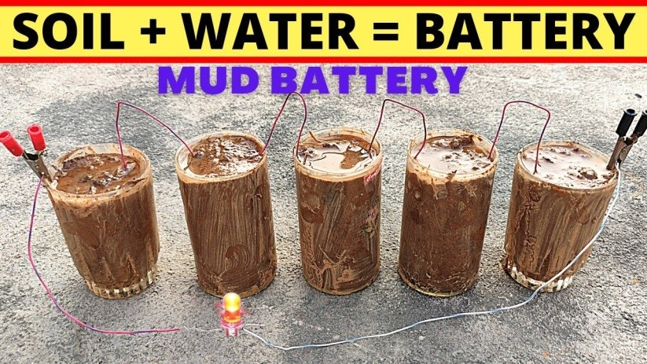
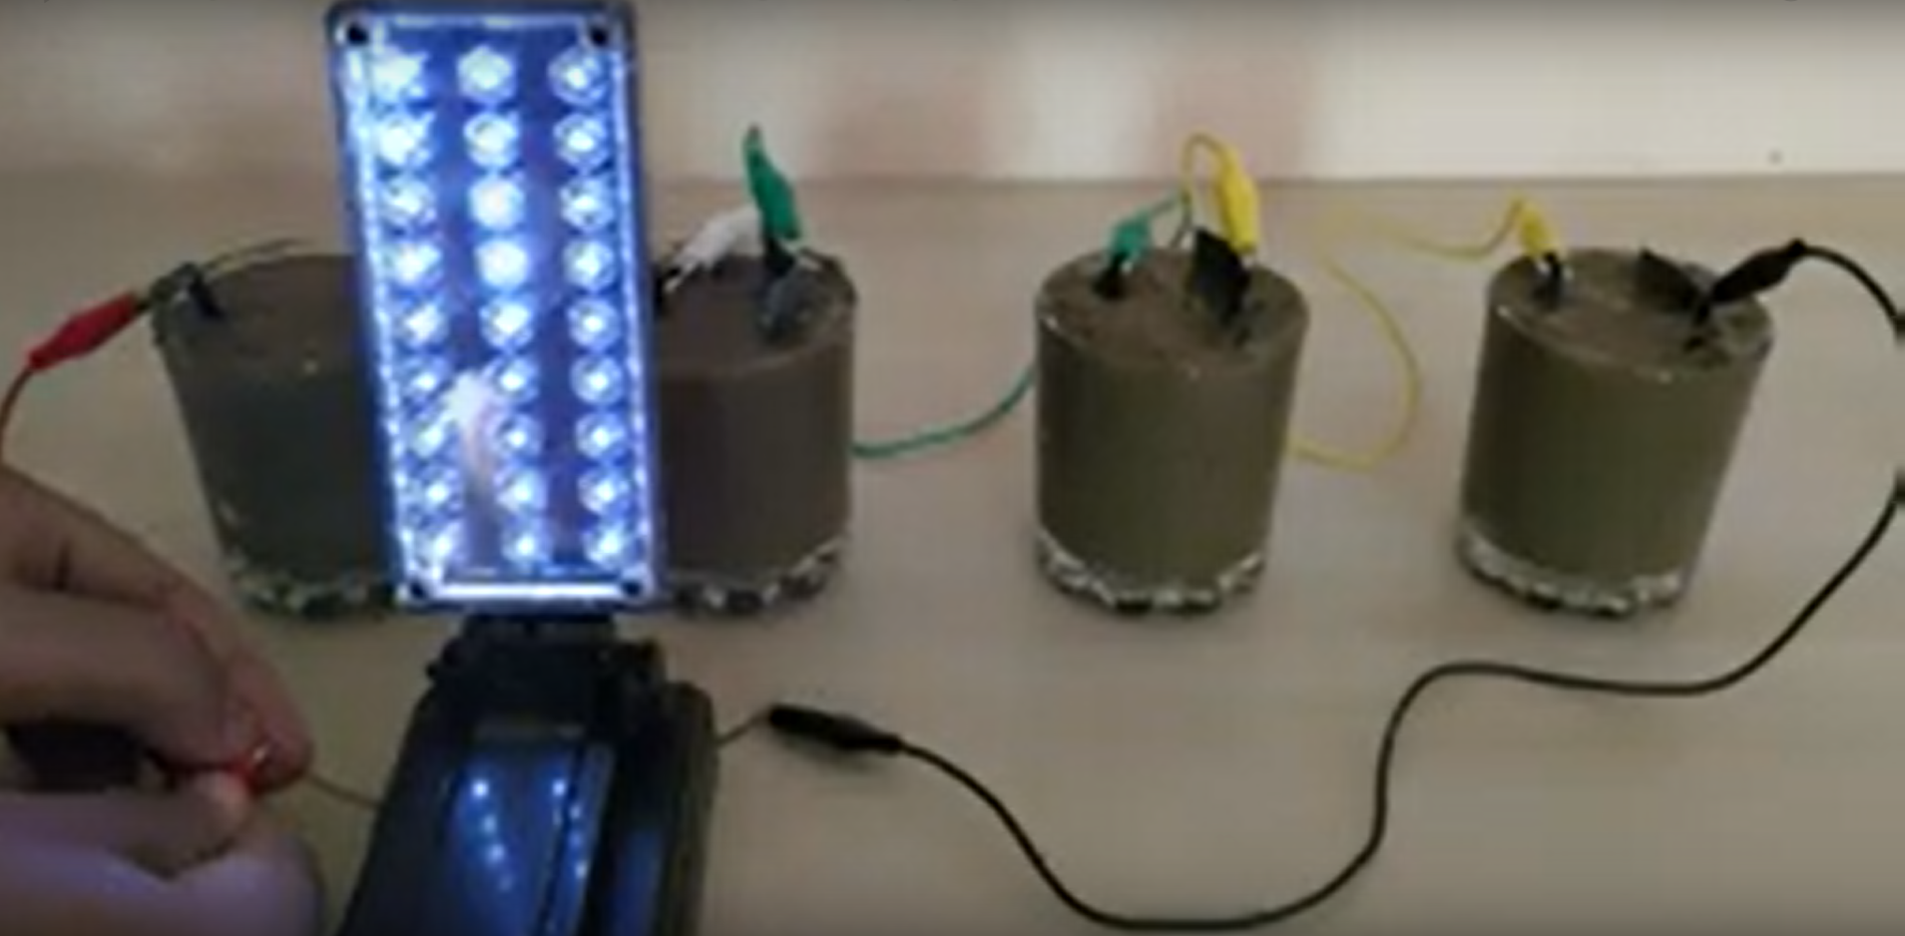
Low-Fidelity Prototype
https://www.youtube.com/watch?v=iQlMRxqWACM&list=PPSV

Slide 13
Conclusion
The Earth Battery solution is a cost-effective, sustainable, and reliable energy source that is directly tailored to the needs of the communities we are serving.
It uses locally available, eco-friendly materials, requires minimal maintenance, and can be easily scaled to meet various energy needs.
This approach provides a practical alternative to traditional renewable energies, addressing the gap in underserved communities while being environmentally friendly.

Slide 14
Thank you!

